Slide 1





MAPPING THE WORLD
Presented by,
Rupali Tasnim Samad (1208)
Tashfia Jannath (1223)
Supervised by,
Moumita Asad
Lecturer, IIT DU
1

Slide 2

Mapping The World is a website with many features to learn all about the countries of the world. Using modern technology, this application will help to quench the thirst of knowledge lovers and will also be beneficial for students.
WHAT IS MAPPING THE WORLD?
2

Slide 3
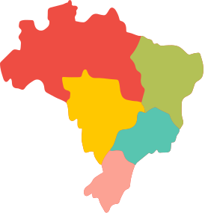









Country Explorer
Climate Insights
Ocean and Seas
Interactive Quizzes
Sports Showcase
Gaming Quiz
Travel Destinations
Global Chat
Union Connections
Enhancing Global
Knowledge
OVERVIEW
3

Slide 4
Normal Requirements
Explore countries' information based on history, culture, and general facts (population, capital, official language) by clicking on a country on the world map.
Discover details about oceans and seas by selecting and clicking on them on the displayed world map.
Identify cricket and football playing countries by clicking on the respective options in the sports tab on the world map.
QFD
4

Slide 5
Normal Requirements
Discover countries with iconic tourist destinations marked on the world map and access information about those destinations by clicking on the specific countries.
Explore countries belonging to associations like SAARC, ASEAN, GCC, etc. by selecting the respective options and viewing the marked countries on the world map.
Access climate information of countries by selecting and clicking on them on the world map.
QFD (CONTD.)
5

Slide 6
Normal Requirements
Engage in quizzes: Multiple-Choice Questions (MCQ)
gaming quizzes based on locating countries on an unmarked map.
Interact with users worldwide through the map's chat feature.
QFD (CONTD.)
6

Slide 7
Expected Requirements
Two types of users can create accounts. Then users can login by providing correct information.
Admin - change informations
User - chat, play quiz
Gamification in quiz system
Database management
QFD (CONTD.)
7

Slide 8
Exciting Requirements
Extending it for Space
Voice command implementation about information for each country in Bangla language for accessibility.
QFD (CONTD.)
8

Slide 9
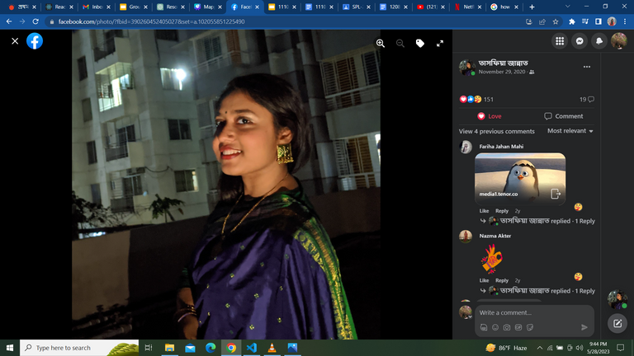
Tashfia Jannath
Authentication module - signup, login
Implementing quiz system with gamification (level up feature and showing leaderboard)
Implementing the gaming quiz with leaderboard by manipulating map
CSS styling
Built data models based on which data will be stored in the system
Role management for admin and normal users
Implementing admin features such as manipulating quiz questions
Front end validation
CONTRIBUTIONS OF EACH MEMBER
9

Slide 10

Rupali Tasnim Samad
Implementing chat system feature
API integration for chat
Implementing the feature to download information about each country
CSS styling
Front end validation
Creating the clickable map using react simple maps
Web scraping for showing all necessary information
Implementing travel, sports, climate, union module by manipulating the map
CONTRIBUTIONS OF EACH MEMBER
10

Slide 11
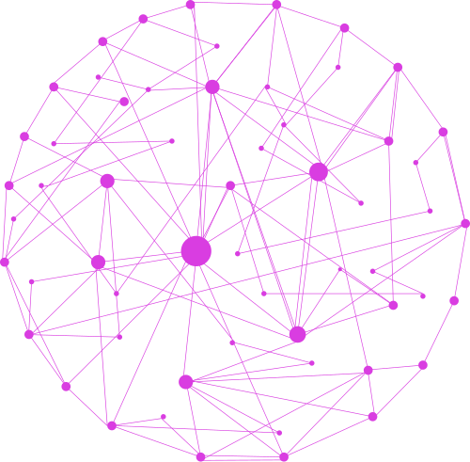
Thanks!
11

